Slide 1

Toddle Optimization
Project by Raj Jadhav
Notes:
3 seconds
In alignment with the Pyramid Principle, start your presentation by letting the audience know upfront what is your investment decision for the company. The rest of the presentation will build upon this decision.

Slide 2
Agenda
General Recommendations
Problem Statement
Company Overview
Actionable recommended solutions
Reasons for existing problems

Slide 3
PROBLEM STATEMENT
Statement 01
Identifying problem areas that slow down the onboarding process and propose actionable solutions to address them
Statement 02
Design a set of product adoption health metrics categorizing them as Excellent, Concerning, and Poor and in addition, propose three solutions for each cohort to enhance their health score and overall product adoption formatting.

Slide 4


Toddle
Toddle is a collaboration platform for teaching teams; Toddle is to teaching, what Figma is to design. Toddle’s mission is to amplify teaching for 60 million K-12 educators globally and support them in delivering meaningful and personalized learning experiences.
Major reasons for delay in onboarding
Training period
Go live timeframe
Notes:
30 seconds
This slide should provide a brief overview of the company by answering 2 very simple questions:
What problem is the company trying to solve?
What is their solution?
This sets the stage for a deeper dive into the specific reasons that makes/does not make the company a promising investment opportunity.

Slide 5
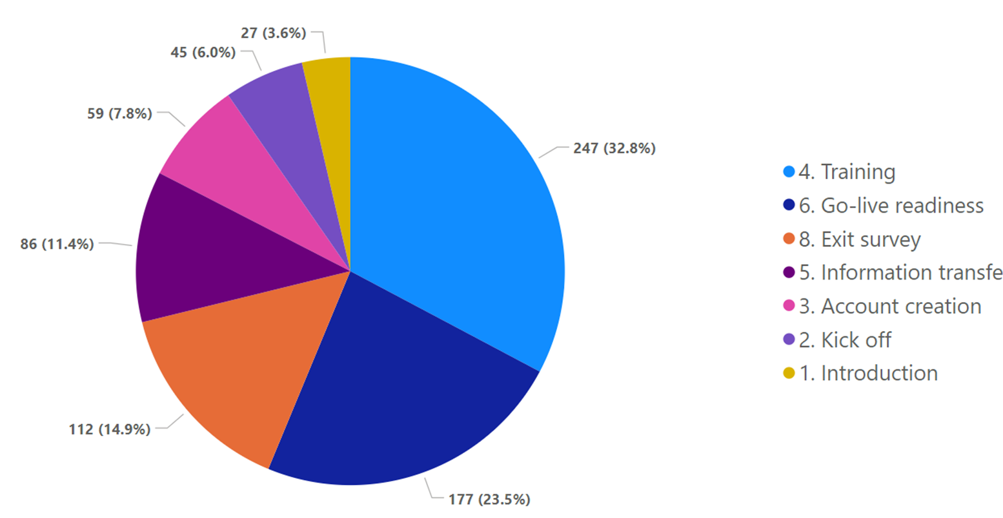
Almost 56% of Onboarding days are spent on onboarding and go live readiness

Slide 6
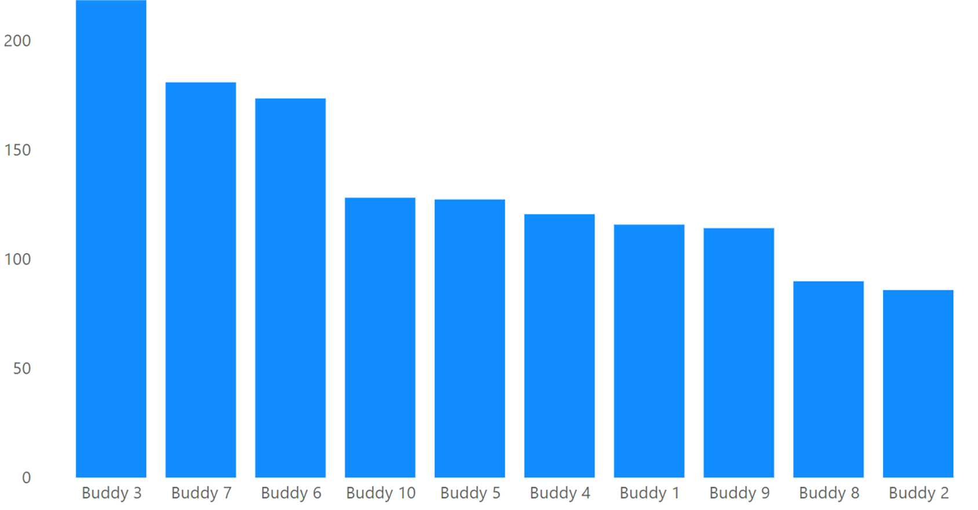
Buddies 3,7,6 are facing significantly higher training and go live times as compared to other toddler buddies [ suggestion: Check for any particular schools associated with these buddies having significantly higher onboarding times ]

Slide 7
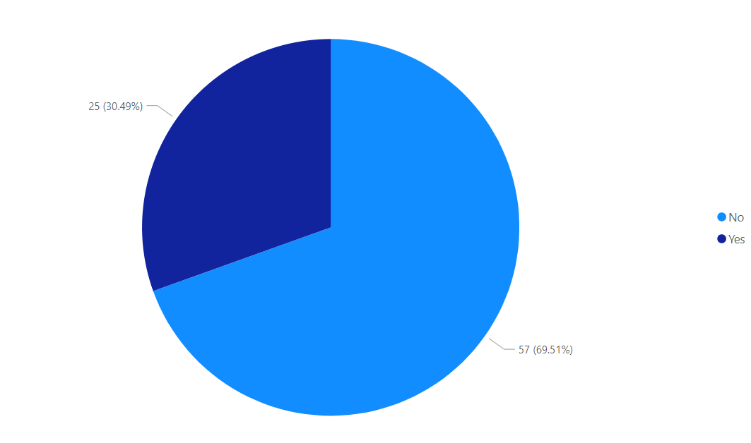
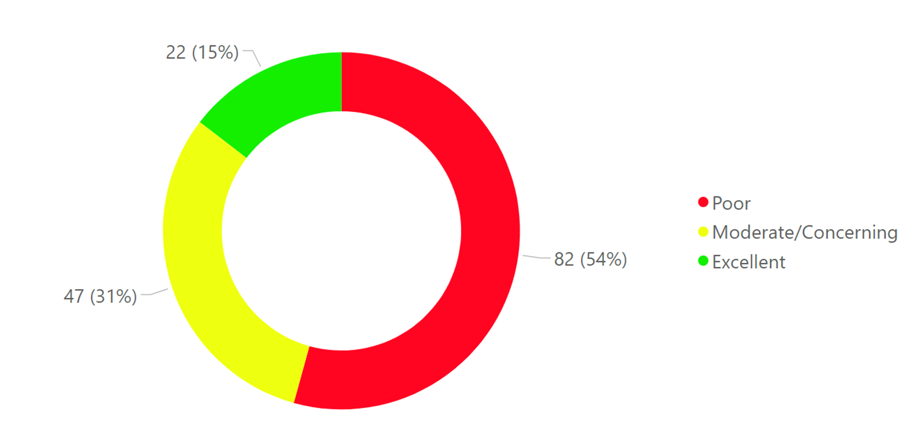
Around 50 % of schools have poor adoption.....
30% of those are strategic accounts !!!
.

Slide 8






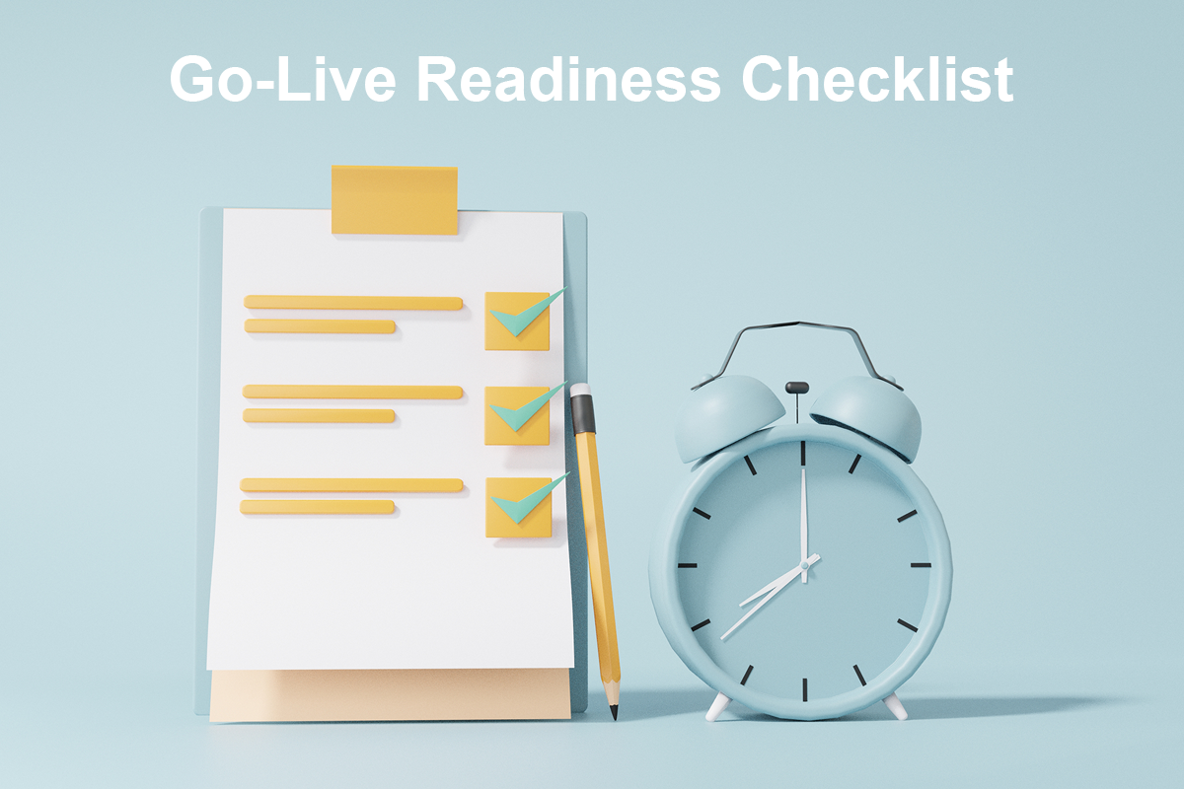
Proposed Solutions
Expedite Training Process
Expedite Go Live Readiness
Go Live support
Incremental Rollout Approach
Customized self learning (training) modules
Go Live Checklist
Revise Training Curriculum
Pre and Post Go- Live Workshops
Train the trainer chain
Online training webinars
.

Slide 9


Strategies to improve adoption health metrics
Moderate/concerning health
Excellent health
Poor Health
1] Continuous monitoring of adoption and risk metrics (KPI’s) and if score below 400
2] Tailored Training, Support, and Engagement with Buddies 3,10
3] Check for any bugs or issues associated with Pro plan
4] Expediting the payment process
1] Continuous monitoring of adoption and risk metrics (KPI’s) and score below 400 but above 72
1] Maintain Adoption score above 500
2] The likelihood of health indicator to be excellent increases 2.7 times if buddy 7 is associated.
2] Tailored Training, Support, and Engagement with Buddy 6
3] Check for any bugs or issues associated with 360 plan
3] Excellent health chances increase by 3 times if risk tag is not at risk
Notes:
50 seconds
To craft the arguments in favor of investing in the company, you can:
Emphasize the team's industry experience, leadership qualities, and past successes. A capable team is crucial for navigating challenges and driving the company's growth;
Discuss the company's technology, product uniqueness, and any intellectual property (IP) status. Highlight how these factors contribute to a competitive edge in the market and the potential for long-term sustainability.
Showcase evidence of commercial traction, such as sales growth, partnerships, or customer testimonials. This demonstrates market demand and the company's ability to execute its business model effectively.
Detail the company's value proposition and how it uniquely addresses customer needs better than existing alternatives. This underlines the company's potential to capture and expand its market share.
Describe the size and characteristics of the target market, including trends that suggest the market is expanding or underserved. This indicates the potential for scalable growth.
Present an overview of the company's financial health and growth metrics. Highlight any positive trends in revenue, profitability, or other key financial indicators that signal a strong investment return potential.
It’s not important to cover all the points, but the points that are the strongest.
Remember, the goal is to weave these components into a narrative that tells a compelling story about the company's potential. Tailor your arguments to resonate with the specific interests and priorities of the target audience/market conditions, whether they're looking for groundbreaking innovation, market disruption potential, or robust financial returns.

Slide 10

General Recommendations
Incentive/Rewards: Reward top 5 schools [ Schools 62, 136, 93, 3, 132 in descending order of adoption, (revenue from 62)] and Offer discounts, promotional offers, or partnerships with relevant educational resources
Peer to peer collaboration: Facilitate collaboration and knowledge sharing between schools. Organize webinars, workshops, or networking events where schools with successful adoption can share their experiences and best practices with those struggling to adopt the platform.
Simplify the Platform: Review the platform's user interface and experience. Make sure it is intuitive and user-friendly, especially for users with varying levels of digital literacy.
Continuous Improvement: Continuously seek feedback through personalized support from users and incorporate their suggestions into platform updates and enhancements. Show that their feedback is valued and acted upon

Slide 11
Thank you for your time and attention 🙂

Slide 12
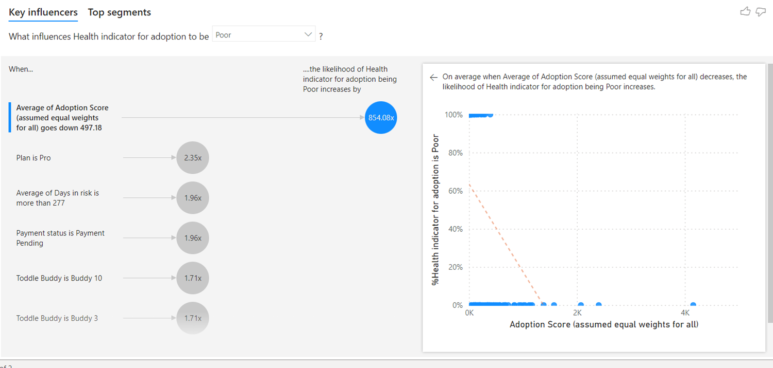
Appendix

